Slide 1
Lecture 6
Operating Systems (COMP1562)

Slide 2

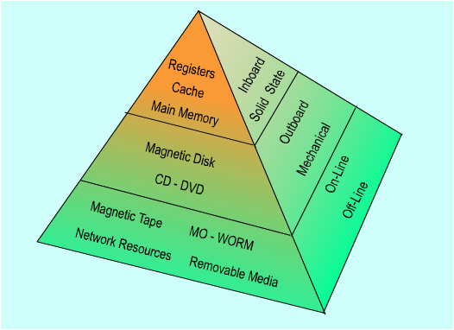
Memory hierarchy
(Stallings)
Mariusz Pelc © 2012/2013
(with support from Dr Kevin McManus and Cos Ierotheous)

Slide 3
Solid state memory
Random Access Memory (RAM)
  volatile
  address bus
    one dimensional
      often implemented at device level as 2 dimensional
  data bus
    word width
DRAM - Dynamic RAM
  charge storage on a capacitor
  cheap, slow (~50nS), low-power consumption
  used for main memory
SRAM - Static RAM
  flip-flop circuit
    same as used for processor registers
  expensive, fast, high-power consumption
  used for cache memory
Mariusz Pelc © 2012/2013
(with support from Dr Kevin McManus and Cos Ierotheous)

Slide 4
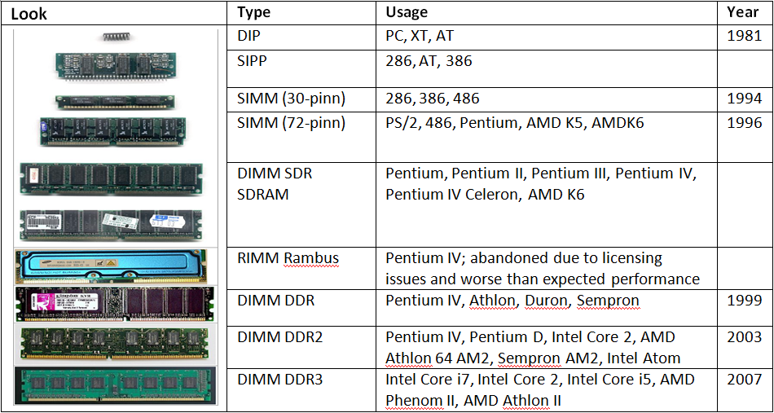
DRAM types
Mariusz Pelc © 2012/2013
(with support from Dr Kevin McManus and Cos Ierotheous)

Slide 5
Address space
Memory is usually seen as a set of bytes indexed by addresses. However, this space can be differently addressed at the architecture level (physical addresses) and differently addressed at the operating system level (logical addresses).
Address space is a set (range) of all allowed (valid) memory addresses.
Depending on address character, we can have:
physical space - set of addresses referring to the main (physical) memory units (),
logical space - set of addresses being generated by the processor in the context of currently running processes.
Mariusz Pelc © 2012/2013
(with support from Dr Kevin McManus and Cos Ierotheous)

Slide 6
Logical and physical address
Memory Management Unit (MMU)
Physical address
Logical address
Address reference
Processor
ALU
Registers
Control Unit
Fig.1 Logical and physical address
Mariusz Pelc © 2012/2013
(with support from Dr Kevin McManus and Cos Ierotheous)

Slide 7
Conversion of logical address into physical - example
The physical address may be created for example by shifting the logical address. In this way any process logical address space may be constructed independently from it’s real placement in the memory determined at it’s execution.
Address shift
register
MEMORY
1024
Processor
+
25
1049
Logical address
Physical address
MMU
Fig.2 Addresses conversion
Mariusz Pelc © 2012/2013
(with support from Dr Kevin McManus and Cos Ierotheous)

Slide 8


Address validation
Boundary
register
Address shift
register
MEMORY
512
1024
Is it valid?
N
Y
25
+
1049
Physical address
25
MMU
Processor
Fig.2 Addresses conversion
Mariusz Pelc © 2012/2013
(with support from Dr Kevin McManus and Cos Ierotheous)

Slide 9
Memory partitioning
Partition memory into blocks that are allocated to processes
  provide contiguous address spaces
    efficient mapping of logical to physical address
  fixed or static partitions
    equal-size
    unequal-size
  dynamic partitions
Mariusz Pelc © 2012/2013
(with support from Dr Kevin McManus and Cos Ierotheous)

Slide 10


Memory partitioning – fixed partitioning
OS
8M
OS
8M
8M
2M
4M
0x0000
6M
8M
OS
(System kernel)
Memory
For
processes
Interrupt
vectors
8M
8M
Memory
For
processes
Memory
For
processes
8M
8M
12M
OS
(System kernel)
OS
(System kernel)
8M
0xFFF...
8M
16M
8M
Mariusz Pelc © 2012/2013
(with support from Dr Kevin McManus and Cos Ierotheous)

Slide 11
Fixed partitioning
Unequal size partitions
  more flexible
  choose the smallest partition that can accommodate the process
  process queue for each partition
Inefficient use of main memory
  any program, no matter how small, occupies an entire partition
  this is called internal fragmentation
Mariusz Pelc © 2012/2013
(with support from Dr Kevin McManus and Cos Ierotheous)

Slide 12
Fixed partitioning – problem of too small partitions – memory overlaying
A very important may occur in case of a process is requestion bigger memory fragment than size of system partition (a process is bigger than partition). In this case usually the operating system provides some specific data structures and special technique called overlaying. Overlaying is spliting of the code (not data!) into some independant parts and replacing one needed part (overlay) with another. The size of an overlay is limited according to memory constraints.
Mariusz Pelc © 2012/2013
(with support from Dr Kevin McManus and Cos Ierotheous)

Slide 13
Memory overlaying
Key:
- Processess
Overlays
- Free memory
Mariusz Pelc © 2012/2013
(with support from Dr Kevin McManus and Cos Ierotheous)

Slide 14
Memory overlaying
- Fixed section
- Overlay section
Key:
Overlays
- Fixed section
- Overlay 1
- Overlay 2
- Free memory
Mariusz Pelc © 2012/2013
(with support from Dr Kevin McManus and Cos Ierotheous)

Slide 15
Memory overlaying
Limitations of memory overlaying :
The state of the overlay removed from the memory is not being saved, so it cannot be changed
One overlay cannot refero to other overlays directly (data exchange and control transfer is being performed using fixed part)
Overlaying requires detailed knowledge about the code and control flow (a specific coding style is required – some tools may help to do this)
It is a very complex process thus it can be a source of different errors; for this reason it is used only in case of systems of very limited memory.
Mariusz Pelc © 2012/2013
(with support from Dr Kevin McManus and Cos Ierotheous)

Slide 16

Memory partitioning - dynamic partitioning
Operating
System
Load process 1
Load process 2
Load process 3
Process 2 ends
Load process 4
Process 1 ends
Loads process 5
Sufficient free memory
for process 6 but no
fragment large enough to fit it in
Process 1
Process 5
Process 2
Process 6
Process 4
Process 3
Mariusz Pelc © 2012/2013
(with support from Dr Kevin McManus and Cos Ierotheous)
the University of Greenwich
the University of Greenwich

Slide 17
Dynamic partitioning
Partitions are of variable length and number
Processes are allocated only the amount of memory they require
Holes appear in the memory map
  this is called external fragmentation
Use compaction to move processes
  defragmentation reduces external fragmentation
  all free memory appears in a single block
Mariusz Pelc © 2012/2013
(with support from Dr Kevin McManus and Cos Ierotheous)

Slide 18
Internal and external partitioning
Internal fragmentation – leaving unused fragment of address space within the alocated memory part/segment (from the OS point of view this part of memory is used, but in reality it is not fully utilized)
  Typical for the fixed partitioning, the memory allocation units are bigger than required by an application
External fragmentation – division of operating memory into separated fragments, which are not connected one another in the address space (this may relate to the allocated and not allocated memory fragments)
  Typical in the situation, when a part of memory allocated to an application is not fully freed (a part of it remains used)
Mariusz Pelc © 2012/2013
(with support from Dr Kevin McManus and Cos Ierotheous)

Slide 19
External partitioning
Key:
- Processess
- Free memory
New process
Mariusz Pelc © 2012/2013
(with support from Dr Kevin McManus and Cos Ierotheous)

Slide 20
Internal partitioning
Allocated
memory
Used
memory
Unused
memory
Mariusz Pelc © 2012/2013
(with support from Dr Kevin McManus and Cos Ierotheous)

Slide 21
Dynamic partitioning – placement algorithms
Best-fit algorithm
  chooses the block that is closest in size to the request (process size)
    leaves smallest fragment
      efficient
    but requires searching all the free block list
      slow
    poor overall performance
First-fit algorithm
  use first location into which the process will fit
    quick
    processes load in the start of memory
      still has to be searched when trying to find a free block
Next-fit
  use next location into which the process will fit
    fastest
Worst Fit
  use the largest free block
    leaves largest fragment
Mariusz Pelc © 2012/2013
(with support from Dr Kevin McManus and Cos Ierotheous)

Slide 22
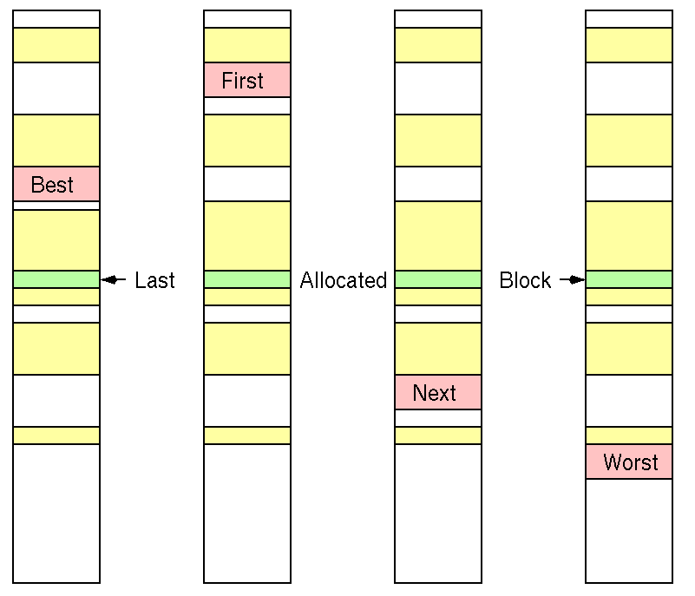
Dynamic partitioning – placement algorithms
Mariusz Pelc © 2012/2013
(with support from Dr Kevin McManus and Cos Ierotheous)

Slide 23
Buddy (twins) partitioning system
U
The available memory for user processes is of size 2
The allocated memory block is of size 2 , where L≤K ≤U and L corresponds to the minimal size of the block allocated
Initially only one block of size 2 is available
Allocation of a memory block of size S is being performed via searching or creation (via division by 2) of a memory block of size 2 so that 2 ≤S≤ 2
If S is out of the above bounds, the block is split into two equal sized buddies; this recurses until the above is met
K
U
i-1
i
i
Mariusz Pelc © 2012/2013
(with support from Dr Kevin McManus and Cos Ierotheous)

Slide 24
Buddy (twins) partitioning
512KB
256KB
256KB
512KB
256KB
256KB
128KB
64KB
64KB
128KB
240KB
250KB
100KB
64KB
Mariusz Pelc © 2012/2013
(with support from Dr Kevin McManus and Cos Ierotheous)

